Slide 1

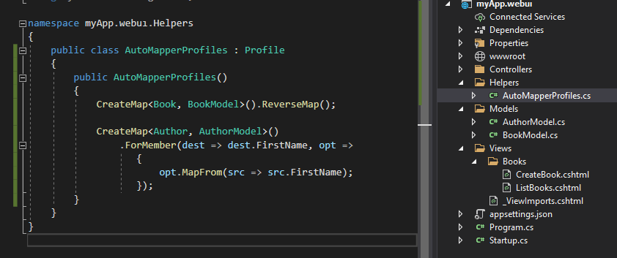

Assembly!

Slide 2



